Slide 1
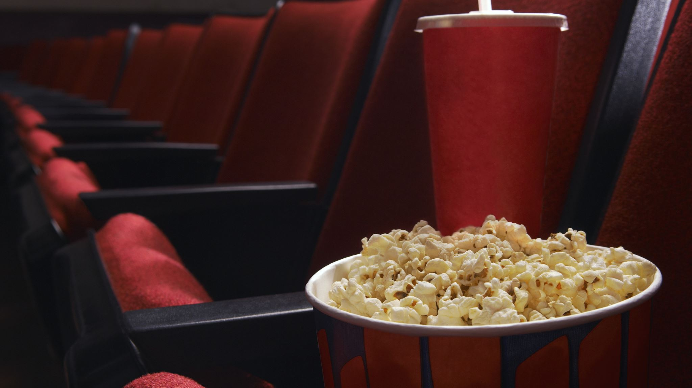
Movie Genre Classification Based on Summaries
Fine-Tuning Llama 2 with LoRA for Efficient Multi-Label Classification
Authors: Charles Rizk, Tania Badran
Professor Salem Othman, Ph.D
Affiliation: Wentworth Institute of Technology
Date / Conference Information

Slide 2

Introduction & Motivation
Accurate Genre Classification Matters:
Reliable genre classification is essential for streaming platforms—it helps tailor recommendations and makes content discovery easier for users.
Challenges with Traditional Methods:
Manual tagging is time-consuming, inconsistent, and subjective. Rule-based methods struggle to capture the nuances of movies that span multiple genres.
Impact on Recommendations and User Satisfaction:
Better genre tagging leads to more precise recommendations, increased user engagement, and ultimately higher satisfaction. This drives retention and gives platforms a competitive edge.
Our Approach:
By leveraging advanced NLP techniques and fine-tuning transformer models, we aim to automate and improve genre classification, addressing the shortcomings of manual and rule-based systems.

Slide 3

Problem Statement
Multiple Labels per Movie:
Movies often belong to several genres, making the task inherently multi-label.
Overlapping Genres:
Many genres share common themes, which increases prediction complexity.
Imbalanced Data:
Some genres are much more common than others, complicating model training.
Need for Efficiency and Scalability:
We require a model that is both accurate and scalable to handle real-world streaming data.

Slide 4

Data Overview
Source:
IMDb summaries and MovieLens genre labels (sourced from Kaggle).
Key Features:
Includes movie overviews, genre labels, and additional metadata.
Dataset Size:
Started with 10k examples; expanded to 40k for improved performance.

Slide 5

Data Preprocessing
Data Cleaning: Removed entries with missing overviews or genres to ensure quality.
Genre Extraction: Parsed raw string genres into lists for easier processing.
Label Encoding: Utilized MultiLabelBinarizer to convert genre lists into multi-hot vectors.

Slide 6

Tokenization & Input Preparation
Using
Using Hugging Face's AutoTokenizer
Tokenizing
Tokenizing movie summaries with padding/truncation to 256 tokens
Creating
Creating Hugging Face Datasets for training and validation

Slide 7

Model Architecture
Choice of Model:
We use DistilBERT as our efficient proxy for Llama 2, striking a balance between performance and computational efficiency.
Transformer Fundamentals:
Built on self-attention and stacked encoder layers, it effectively captures both local and global context in movie summaries.
Transfer Learning:
Leveraging pre-trained models gives us a strong starting point, enabling us to fine-tune quickly and focus on our specific multi-label task.
Efficiency & Scalability:
DistilBERT is lightweight yet powerful, making it ideal for rapid iterations and deployment in resource-constrained environments.

Slide 8
Introducing LoRA
What is LoRA?
LoRA fine-tunes large models by injecting small, trainable low-rank matrices into the network instead of updating all parameters
Benefits:
It’s super-efficient—only a tiny fraction of parameters is updated, which cuts down on computation and memory use.
Integration:
LoRA is directly integrated into the transformer’s attention layers, allowing task-specific adjustments without retraining the entire model.

Slide 9
Fine-Tuning Strategy
LoRA Integration:
We inject trainable low-rank matrices into key layers, enabling efficient adaptation of the pre-trained model.
Training Parameters:
Learning rate: 2e-5, Batch size: 8, Epochs: 3
Mixed-Precision Training:
Using fp16 for faster training and reduced memory usage.

Slide 10
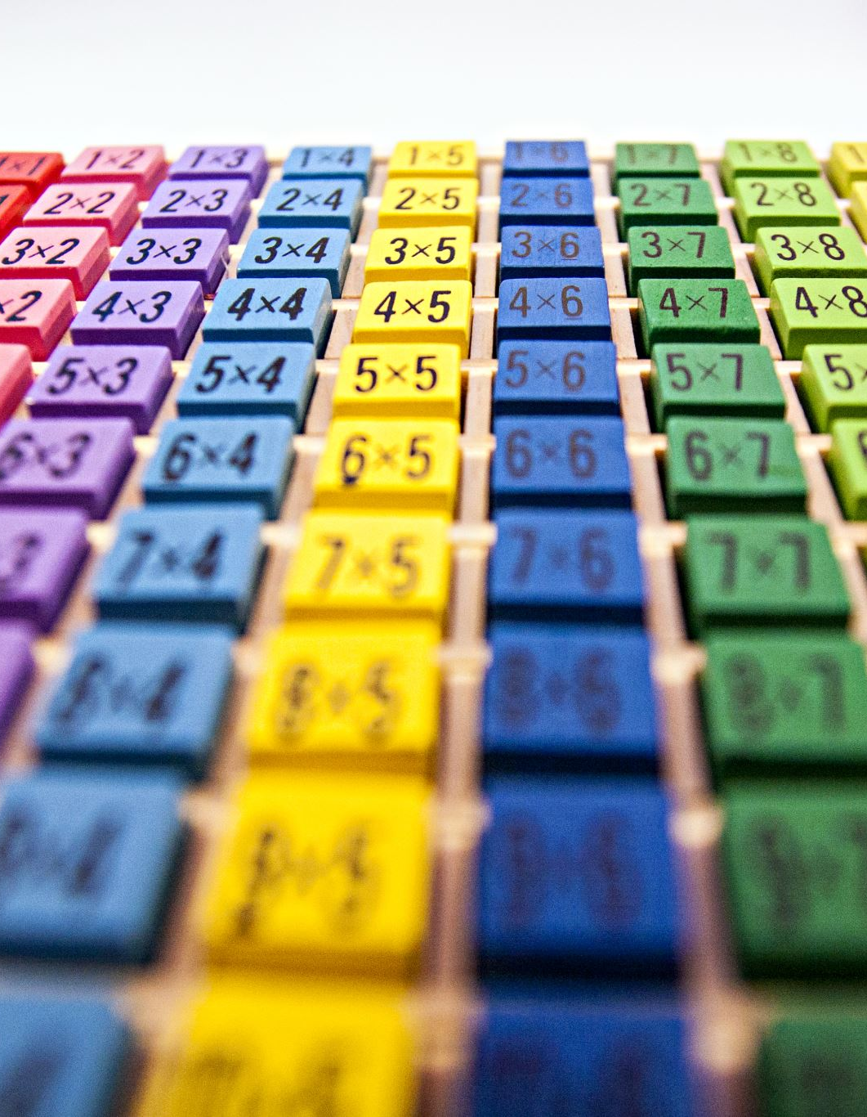
Handling Label Imbalance
Challenge:
With 1624 genres, many labels are extremely rare, causing common genres to dominate the model’s predictions.
Weighted Loss:
We use BCEWithLogitsLoss with a computed pos_weight vector to give extra emphasis to the underrepresented genres.
Model Sensitivity:
This strategy boosts sensitivity for rare classes, improving recall, though it requires careful tuning to avoid increasing false positives.

Slide 11
Training Pipeline Overview
Data ingestion and preprocessing steps
Tokenization and dataset creation
Model loading, fine-tuning, and evaluation with Hugging Face Trainer

Slide 12

Evaluation Metrics
Metrics used: Accuracy, Precision, Recall, F1 Score
Explanation of each metric (with formulas)
Challenges with subset accuracy in multi-label settings

Slide 13

Results – Quantitative Analysis
Summary of evaluation results (e.g., F1 score, recall improvements)
Comparison between different dataset sizes (10k, 40k, etc.)
Discussion on threshold tuning effects on metrics

Slide 14

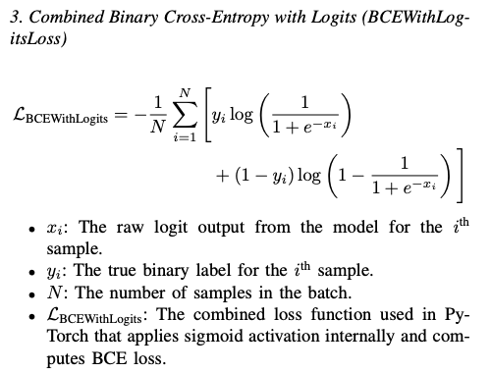
Loss Function & Calibration
Explanation of BCEWithLogitsLoss and sigmoid activation
Role of pos_weight in addressing label imbalance
Discussion on calibration challenges (raw probabilities near 0.5)

Slide 15
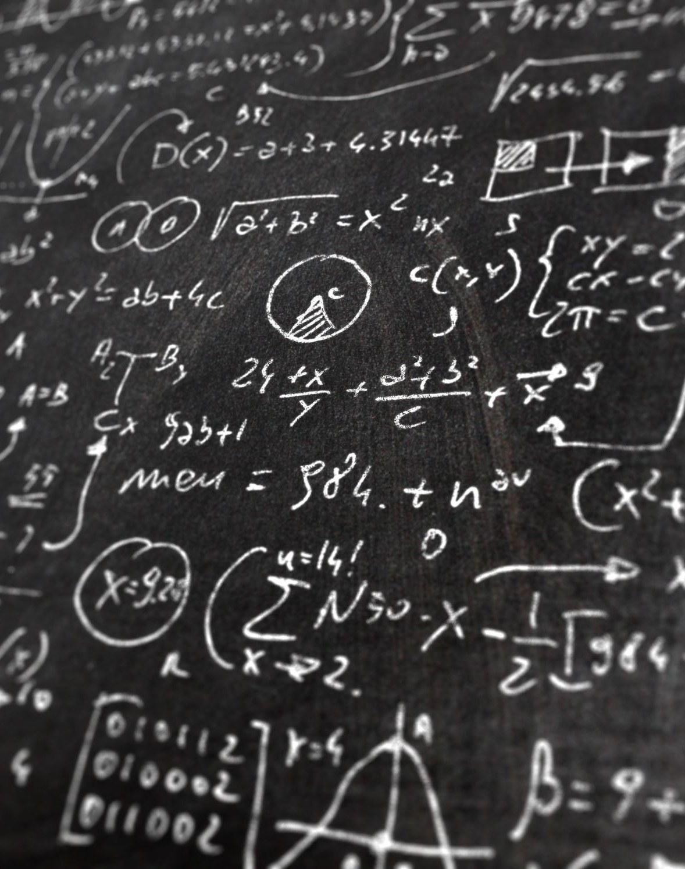
Inference Pipeline
Prediction Process:
The fine-tuned model takes a movie summary as input, tokenizes it, and produces raw logits for each genre.
Logits to Probabilities:
A sigmoid function converts logits into probabilities, indicating the model's confidence for each genre.
Thresholding:
A preset threshold (e.g., 0.5) is applied to these probabilities to determine which genres are predicted as positive.
Example Inference:
For instance, the summary "A thrilling adventure of a man on a quest to save his kingdom" is tokenized, passed through the model, and the output probabilities yield predicted genres like "Action," "Adventure," and "Fantasy" (depending on threshold calibration).
This pipeline enables real-time genre predictions from new movie summaries.

Slide 16

Predictions and Output Format
Display of sample prediction outputs
Discussion of cleaning and formatting predicted labels
Saving results into CSV files for further analysis

Slide 17

Baseline Comparisons
Baseline Models:
Zero-Shot Llama 2: No task-specific fine-tuning; quick but less accurate.
TF-IDF + Naïve Bayes: A traditional method that struggles with multi-label challenges.
Fine-Tuned BERT: A strong transformer baseline but more resource-intensive.
Comparative Performance:
Evaluation using precision, recall, and F1 scores shows that while each baseline has strengths, LoRA-enhanced Llama 2 generally achieves higher recall and better F1 performance with fewer parameters.
Advantages of LoRA-Enhanced Llama 2:
Parameter Efficiency: Fine-tuning only low-rank adapters reduces GPU memory and computational cost.
Rapid Convergence: Achieves competitive performance faster than full fine-tuning methods.
Effective Multi-Label Handling: Better adapts to imbalanced, multi-label scenarios for improved genre prediction.

Slide 18

Discussion and Limitations
Key Findings
Larger datasets combined with a weighted loss improved performance, achieving an F1 score of ~57% (Precision ~52%, Recall ~63%) at an optimal threshold of 0.7.
Subset (exact match) accuracy remains low (~16%), which is common in complex multi-label settings.
Remaining Challenges:
Threshold Tuning & Calibration:
Finding the right global or per-label thresholds is difficult; further calibration of model probabilities may be needed.
Extreme Label Imbalance:
Many genres are underrepresented, which continues to affect performance even with a weighted loss.
Observations:
The model’s high recall shows it captures many true labels.
Lower precision indicates that extra labels are predicted, which adversely impacts subset accuracy

Slide 19

Future Work and Enhancements
Increasing dataset size and diversity
Experimenting with per-label thresholding and advanced calibration
Exploring alternative loss functions (e.g., focal loss)
Incorporating additional modalities (visuals, cast info) and user feedback

Slide 20

Conclusions and Q&A
Recap of objectives and main findings
Summary of the benefits of using LoRA for efficient fine-tuning
Final thoughts on the impact for streaming platforms
Invitation for questions and discussion

